Slide 1
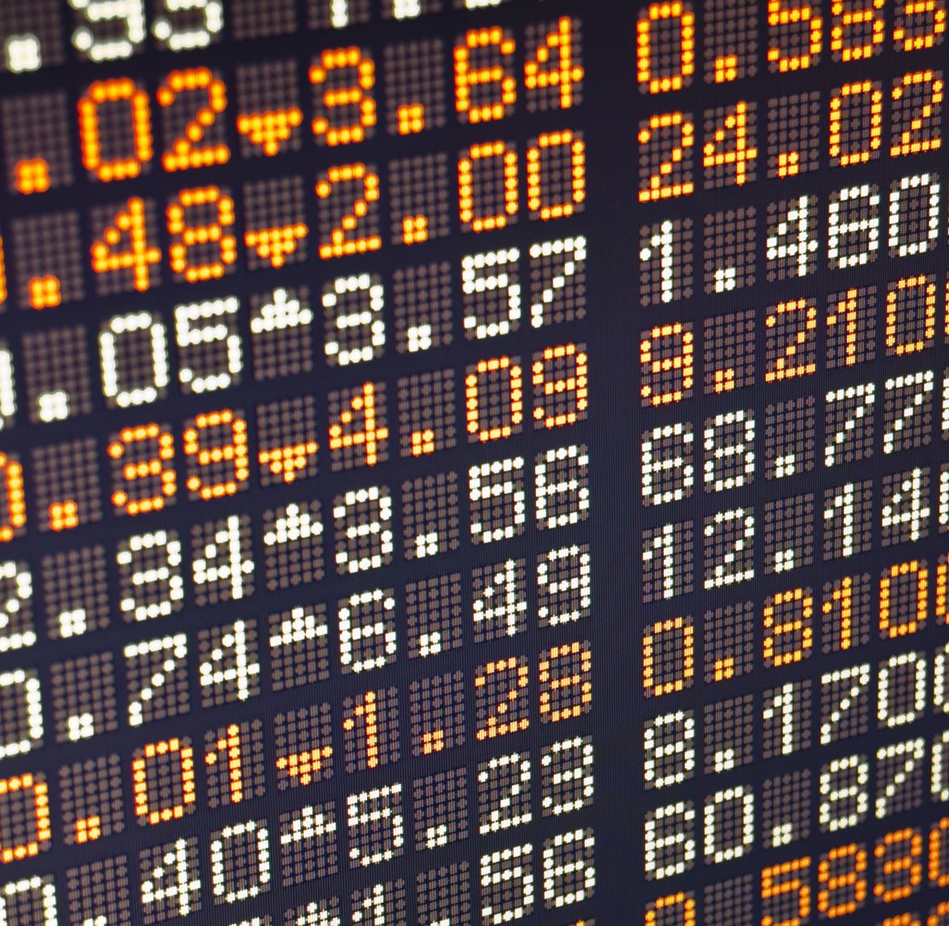
Project 2 : Stock Visualization
Team Members: Edward Chhun, Jackie Yi, Phoebe Wang, Sriven Ankam, Yan Kong, Fatima Carrillo
Date: January 27, 2021
Notes:
Jackie will speak

Slide 2
Python and Jupyter Notebook
Our team worked with a python module to get up to date S&P500 stocks data from Yahoo Finance.
We imported yfinance 0.1.55 (https://pypi.org/project/yfinance/) to the Jupyter Notebook
We had to add a try and except for objects not found
Notes:
Sriven

Slide 3
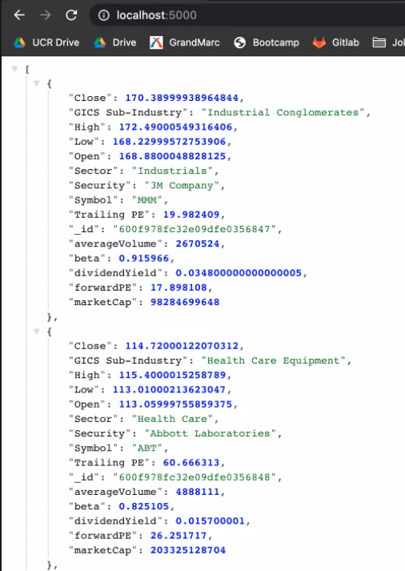
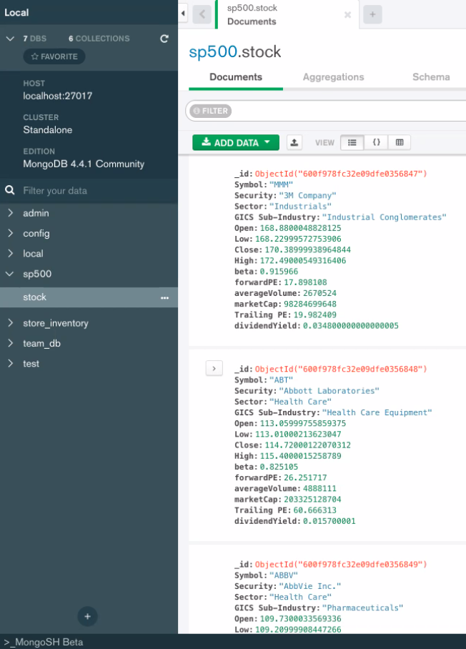
Flask and PyMongo
Utilizing Python API-Flask we created a database with PyMongo
We converted all the S&P 500 tickers into JSON file
Our Flask Code
Notes:
Phoebe

Slide 4
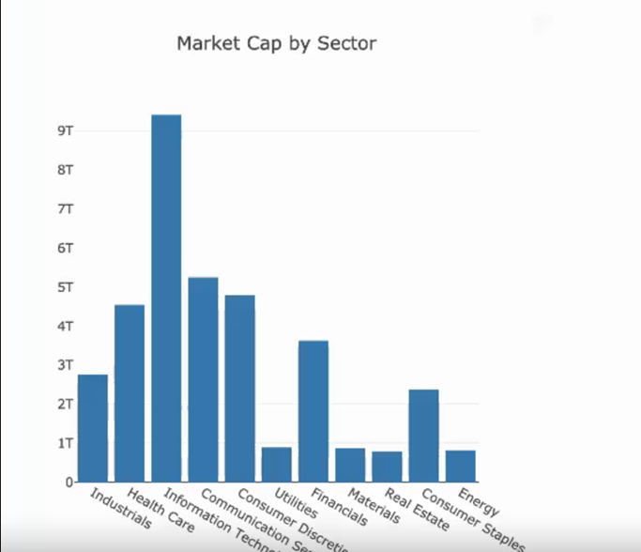
Building our Visualization
We utilized Plotly and Charts. Js for our graphs
Notes:
Yang show Webpage!

Slide 5
Database
Notes:
Fatima: Using D3 we imported our Json into a database and added a filter which allows the user to enter a specific Symbol: Our database includes important information for example: Symbol, Sector, Open Close, High and low.
Show Webpage

Slide 6
Lessons Learned and Roadblocks
Data Flow was very important as we had a hard time ensuring the code was pulling the data in the correct format.
Making sure that NULL values were omitted/able to be read through without breaking our code
An example of this was one of the stocks being delisted the day prior to us pulling data into our Database. It was in the S&P500 as we began to code, but upon finishing it was already delisted.
In creating our data visualizations that we had in mind, the data used was only representative of one day, essentially a snapshot.
We adapted to the data that we collected and ultimately chose our data visualizations based off our one day snapshot data.
Notes:
Edward back to PPT

